Slide 1
Intermediate Report - Performance comparison of MIPv6 and HIP
Simon Curty
Anukriti Shrimal

Slide 2
Objective
Which mobility protocol performs best in certain mobility situations?
Main focus on handover

Slide 3
Mobile IPv6
MN
Home network
Foreign network
Home Agent
Foreign Agent

Slide 4
MN has now 2 addresses:
Care-of address (CoA)
Home address (HoA)
MN
Home network
Foreign network
Home Agent
Foreign Agent
CN
CN wants to send to MN

Slide 5
MN
Home network
MN answers CN
Foreign network
Home Agent
Foreign Agent
CN
If MN and CN support route optimization, they can communicate directly -> triangular routing

Slide 6
Host Identity Protocol (HIP)
MN
Home network
Foreign network
Home Agent
Foreign Agent

Slide 7
Tools and simulation frameworks
OMNet++
INET Framework (for mobility and MIPv6)
HIPSim++ (for HIP)

Slide 8
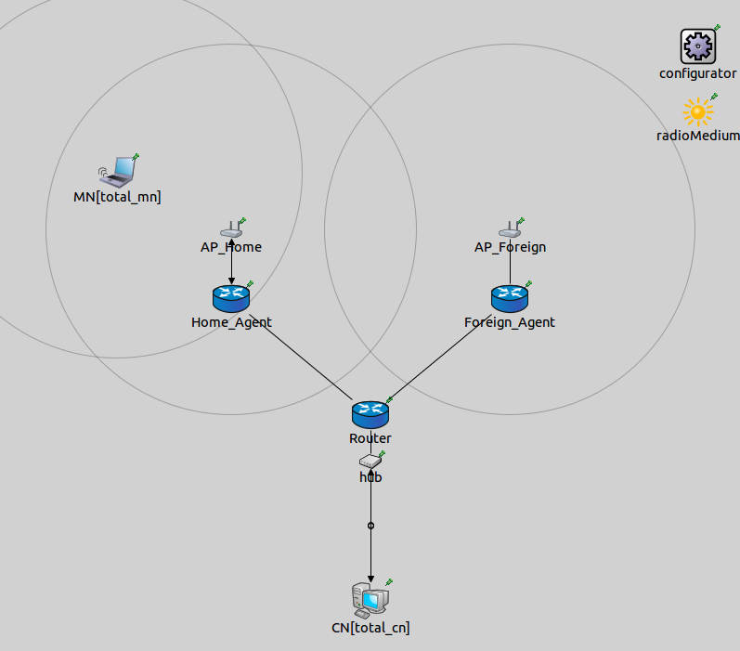
Testbed MIPv6

Slide 9
Testbed HIP

Slide 10
Scenarios
Pedestrian: Movement at 5km/h
In-town traffic: Movement at 40km/h
Train at high speed: Movement at 200km/h
Maybe: (Stationary MN: MN is stationary in the foreign network)
Mobility scenarios with route optimization enabled.

Slide 11
Metrics
Handover latency:
MIPv6: Elapsed time between the moment of disassociation of the MN from the former access point and the instant MN receives the binding acknowledgement message from the CN, while connected to the new access point. [ms]
HIP: Elapsed time between the moment of disassociation of the MN from the former access point and the instant CN receives the third UPDATE package from the MN, while the MN is connected to the new access point. [ms]

Slide 12
What’s next?
Refine Testbeds, conform parameters
Analyse and interpretation of the simulation results
Maybe: Investigate and compare control traffic overhead

